Slide 1

AI Agents for the Optimization of
Thin-Shell Composite Booms
Federico Benazzo and Tara Venkatadri
Lab Report 3 Demonstration of Agent System
Disclaimer: These slides were generated by Claude Opus 5.5 (Anthropic) based on an outline provided by the authors.
Notes:
Suggested presenters are in each slide's notes (edit as needed).

Slide 2
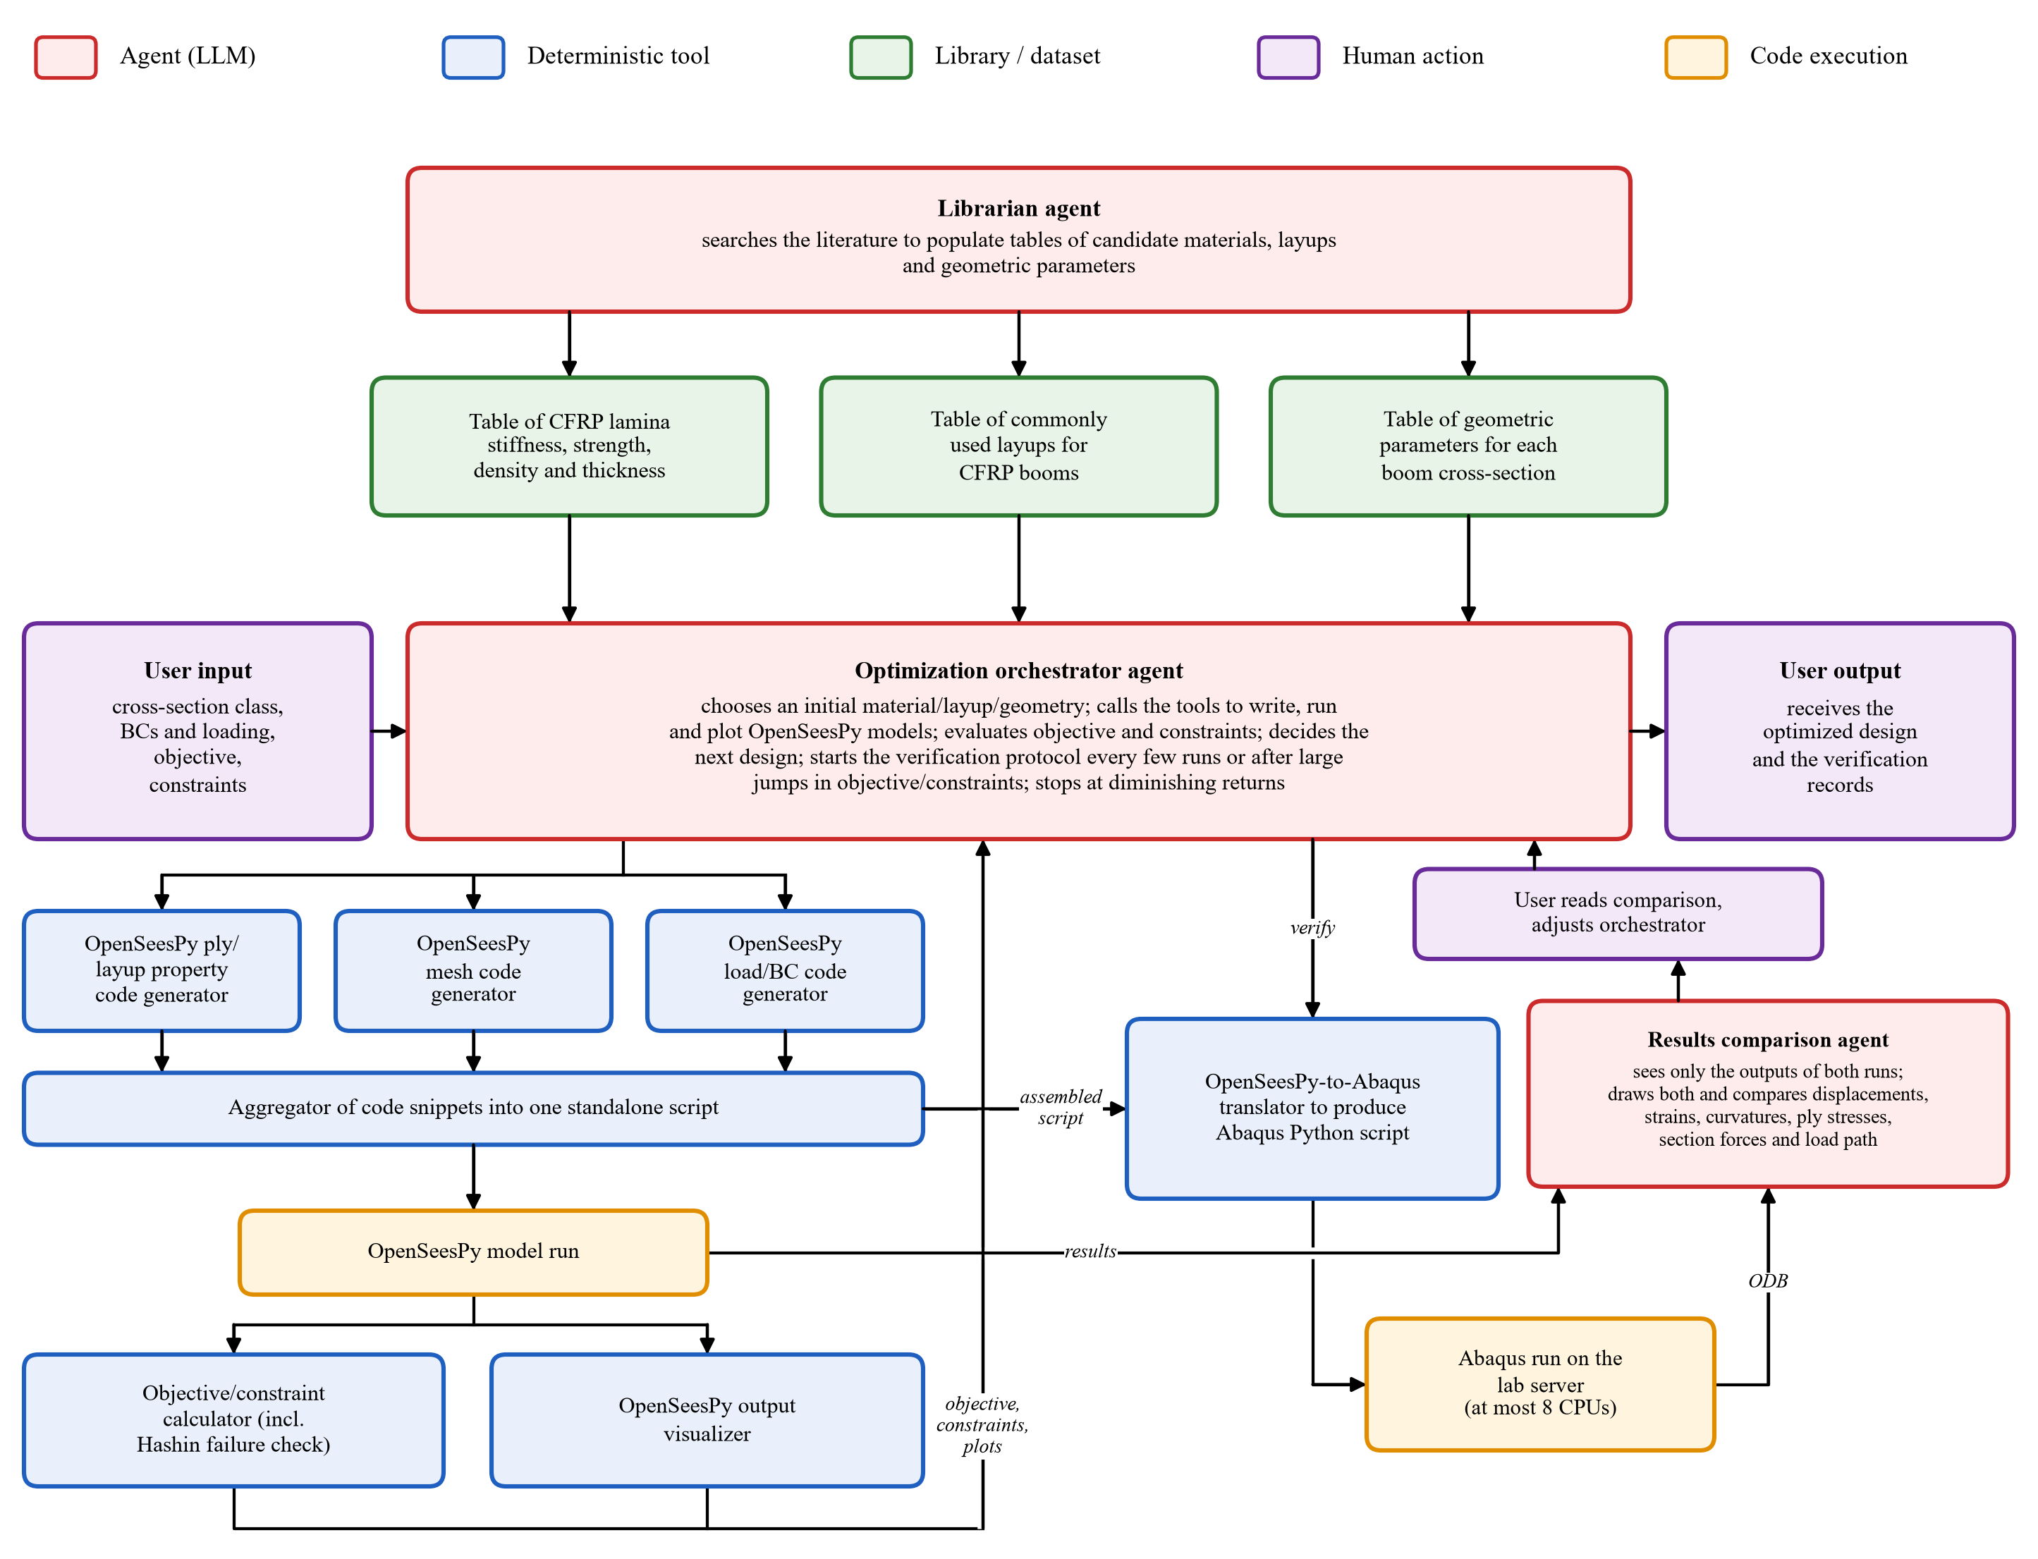

All Modules Built and Tested, Including the Agents
2
Demonstrated on the next slides
✓ Catalogs
librarian agent, slides 3-5
✓ OpenSeesPy write/run pipeline
tools, slides 6-7
✓ Abaqus verification loop
comparison agent, slides 8-9
✓ End-to-end baseline
orchestrator agent, slides 10-13
✓ Failure case
omega boom, slide 14
Notes:
Suggested presenter: Tara.
Full system diagram of 11/4. Every box has been built and tested: the three agents (librarian, optimization orchestrator, results comparison agent), the deterministic tools (Claude Code skills) and the Abaqus loop. Updated from the 11/4 diagram: Claude now runs on the lab server that has Abaqus (the repository lives there), so the two human steps that moved the script to an Abaqus machine and the ODB extract back are gone, and the ODB no longer has to be extracted to plain arrays: the comparison agent reads it directly.
The next slides demonstrate each part with the prompt it received and the output it produced.

Slide 3
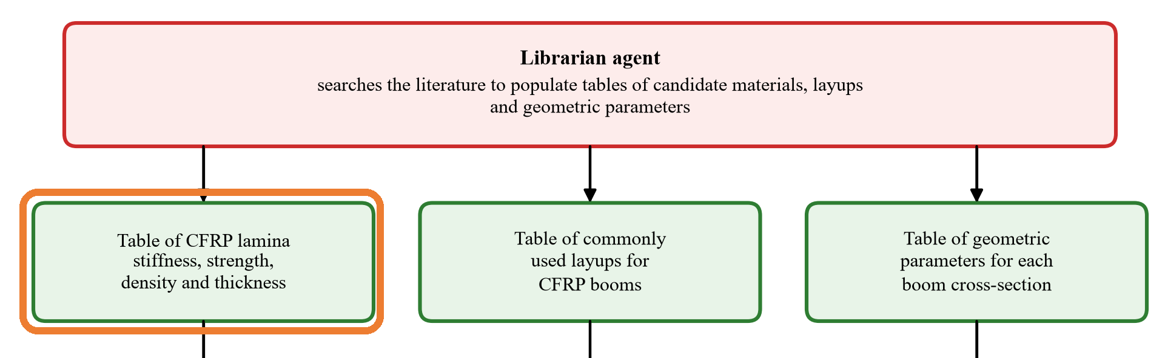
Catalogs: Material Properties
3
Input / Output Example
✓ Working
Input: Federico's prompt to the librarian agent
[Placeholder: screenshot of Federico's prompt that created this catalog]
What this section does:
The librarian is separate from the orchestrator because of a permissions split: it is the only agent with web access. It searches qualification reports, papers and datasheets for unidirectional lamina properties. Each of the 38 rows (L001-L038) has stiffness, strength, ply thickness, density and a source.
Output: sample rows of the material catalog
ID | Fiber/matrix | E₁/E₂/G₁₂ (GPa) | X_{t}/Y_{t}/S₁₂ (MPa) | ρ (g/cm³)
L001 | IM7/8552 epoxy [1] | 158.5/8.95/4.67 | 2501/64.0/91.1 | 1.58
L013 | AS4/3501-6 epoxy [2] | 126/11/6.6 | 1950/48/79 | 1.58*
L024 | Carbon/epoxy [3] | 80.1/6.67/2.93 | 1063/66.0/126.8 | 1.60
L030 | T1100GC/PAEK [4] | 173/9.0/4.03 | 3613/90/69.0 | 1.59
[1] NCAMP (2011). Hexcel 8552 IM7 unidirectional prepreg qualification material property data report, CAM-RP-2009-015 Rev. A.
[2] Soden, P. D., et al. (1998). Lamina properties, lay-up configurations and loading conditions for a range of fibre-reinforced composite laminates. CST, 58(7).
[3] Liu, T.-W., et al. (2023). Folding behavior of the thin-walled lenticular deployable composite boom. Mech. Adv. Mater. Struct., 30(11).
[4] Toray Advanced Composites. Toray Cetex TC1225 (T1100GC/LM-PAEK) product data sheet. * = estimate.
Notes:
Suggested presenter: Federico (built the catalogs).
PLACEHOLDER: paste the screenshot of the prompt that created the material catalog.
Sample rows are copied from .claude/memory.material_property_catalog/UD_lamina_catalog_readable.txt. Every ply is 0.035 mm thick (project decision, 11/5). * = estimate (density by rule of mixtures). Not shown: nu12, nu23, G23, Xc, Yc.

Slide 4
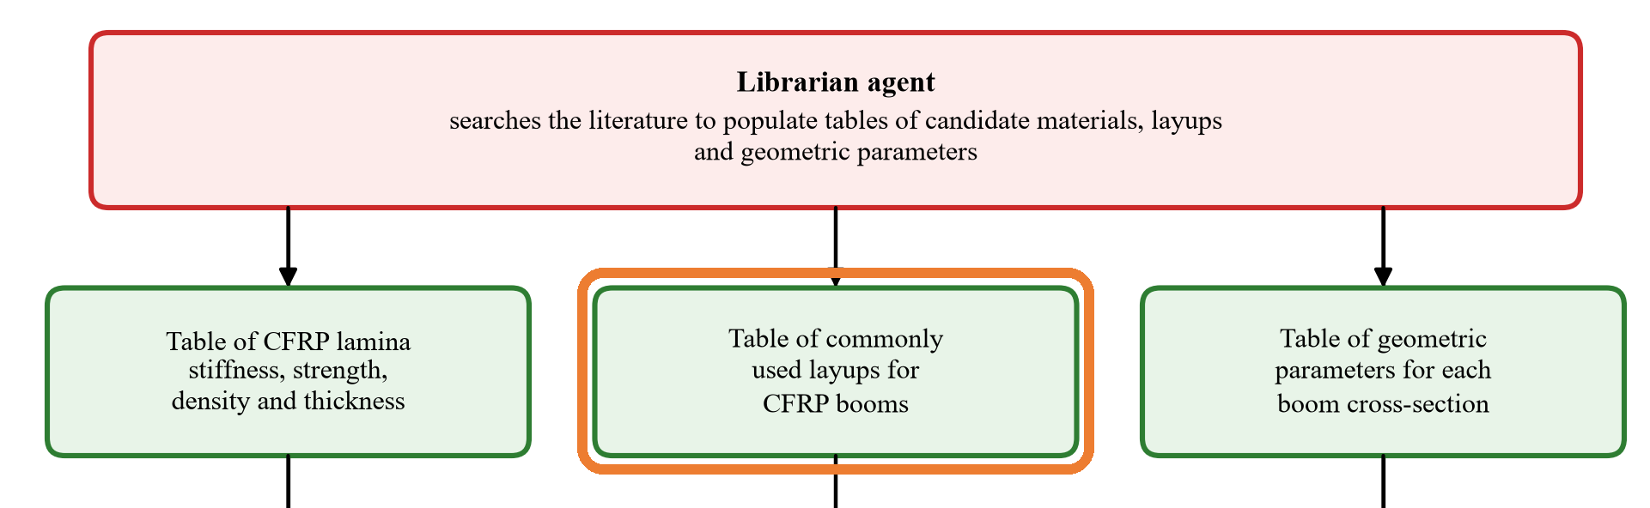
Catalogs: Layups
4
Input / Output Example
✓ Working
Input: Federico's prompt to the librarian agent
[Placeholder: screenshot of Federico's prompt that created this catalog]
What this section does:
The librarian lists every symmetric layup of 3-5 plies with angles 0, ±30, ±45, ±60 and 90 deg and at least one 0 ply: 199 layups (Y001-Y199). Each row gives the thickness t and whether the layup is cross-ply or balanced, so the orchestrator picks from this list instead of inventing layups.
Output: sample rows of the layup catalog
ID | Plies | Layup | t (mm) | Cross-ply | Balanced
Y001 | 3 | [0/0/0] | 0.105 | yes | yes
Y005 | 3 | [0/90/0] | 0.105 | yes | yes
Y016 | 4 | [0/0/0/0] | 0.140 | yes | yes
Y050 | 5 | [0/45/60/45/0] | 0.175 | no | no
Y123 | 5 | [45/−45/0/−45/45] | 0.175 | no | yes
Notes:
Suggested presenter: Federico.
PLACEHOLDER: paste the screenshot of the prompt that created the layup catalog.
Sample rows from .claude/memory.layup_catalog/layup_catalog.txt (199 rows: 15 with 3 plies, 15 with 4, 169 with 5). Symmetric, so B = 0 for every row. Cross-ply = only 0 and 90 plies (no extension-shear or bend-twist coupling); balanced = every +theta ply has a -theta partner (no extension-shear coupling).

Slide 5
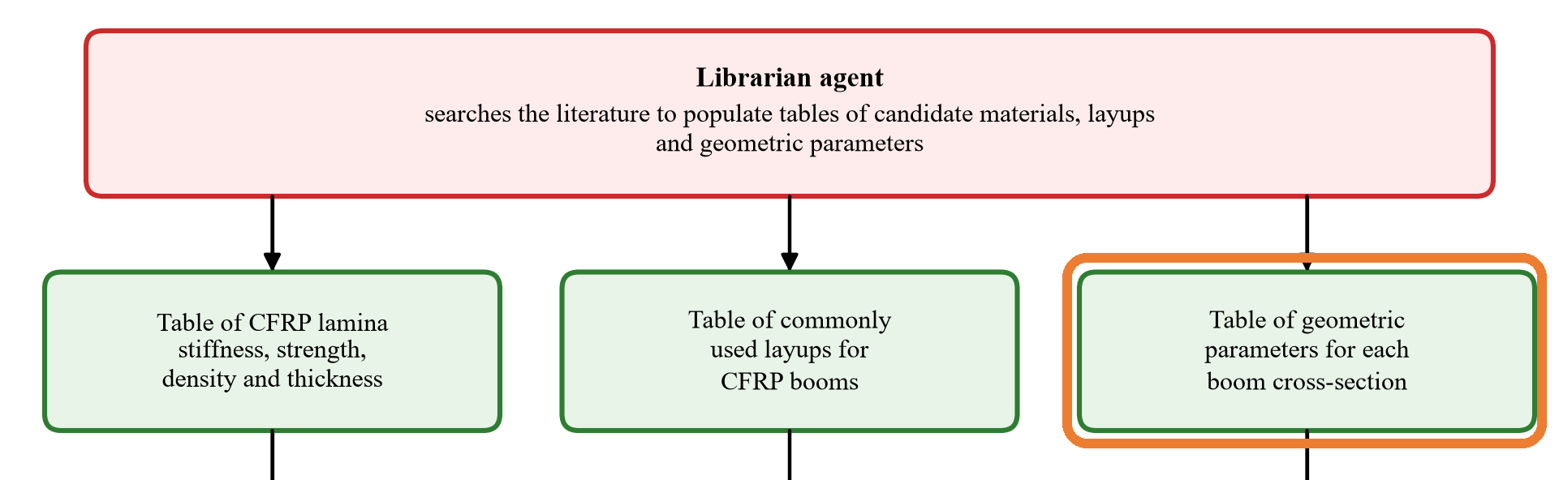
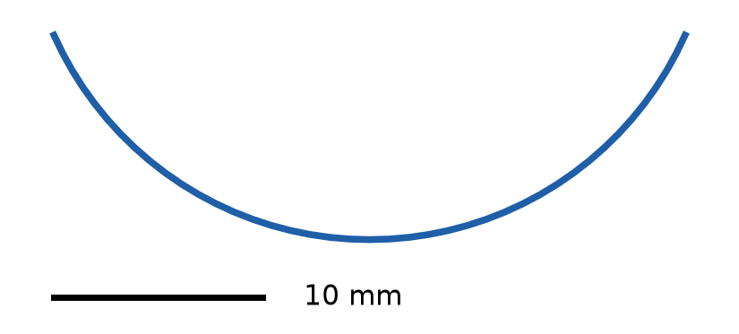
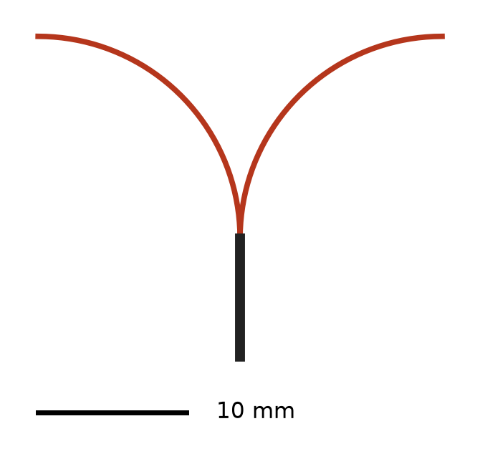
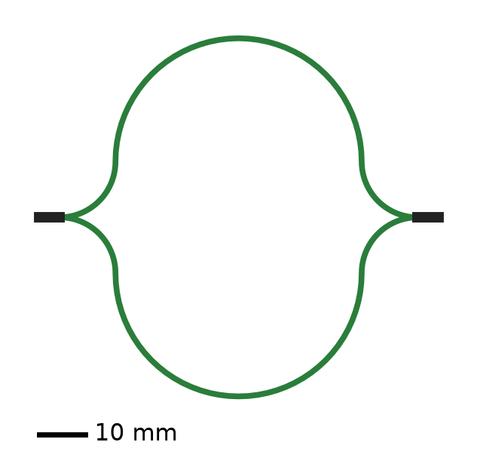
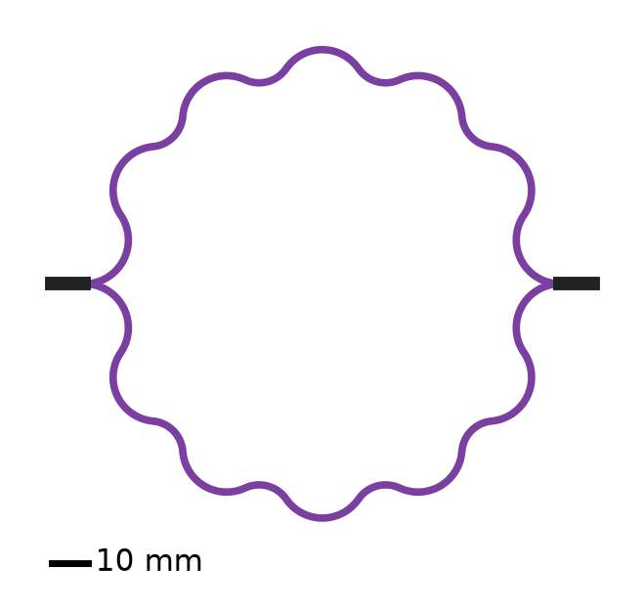
Catalogs: Cross-Section Geometries
5
Input / Output Example
✓ Working
Input: Federico's prompt to the librarian agent
[Placeholder: screenshot of Federico's prompt that created this catalog]
What this section does:
The librarian collected 100 coilable-boom cross-sections: 25 each of tape springs, TRAC, omega and corrugated booms. Each row gives the arc radii and angles and is checked to flatten.
Output: sample rows of the cross-section catalog
ID | Type | Arcs R (mm) / θ (deg) | Size (mm) | Origin
T013 | Tape spring | 16.6 / 131.8 | 30 × 10 | Literature
R011 | TRAC [5] | 13.6 / 90 (2 flanges) | 27 × 22 | Literature
M008 | Omega (CTM) | 12, 26.5, 12 / −90, 180, −90 | 86 × 77 | Literature
C006 | Corrugated [6] | 11 arcs per shell | 148 × 128 | Derived
[5] Benazzo, F., & Pellegrino, S. (2025). Design and manufacturing of ultra-thin thermoplastic composites for coilable longerons. AIAA SciTech 2025 Forum.
[6] Fernandez, J. M., & Volle, C. E. (2021). Corrugated rollable tubular booms. AIAA SciTech 2021 Forum.
Notes:
Suggested presenter: Federico.
PLACEHOLDER: paste the screenshot of the prompt that created the cross-section catalog.
Sample rows from .claude/memory.boom_geometry_catalog/boom_geometry_catalog.txt. Size = width x height of the mid-surface section incl. webs. Every row is checked to flatten (equal flange arc lengths, tangent arcs, no self-intersection). Drawings (bottom left) are made from rows T013, R011, M008 and C006; black = bonded web.

Slide 6
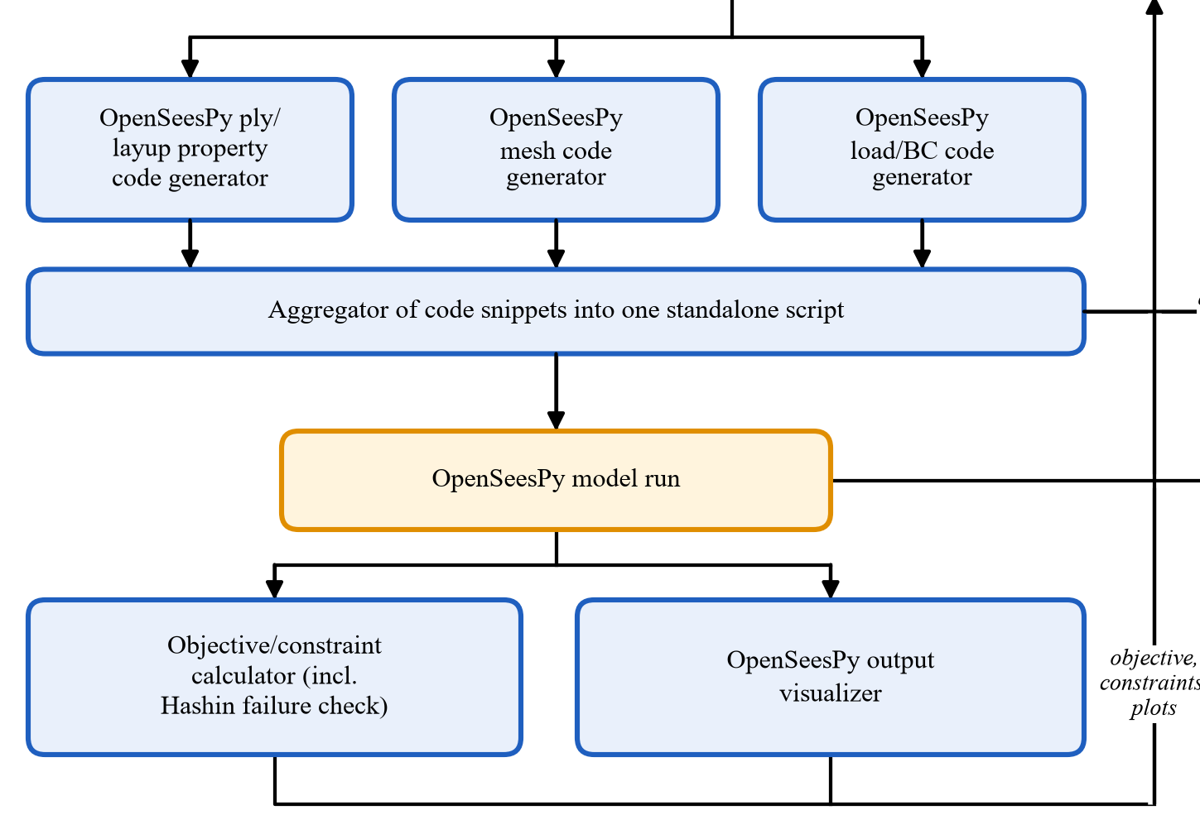
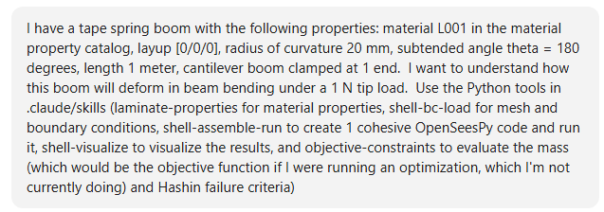
OpenSeesPy Write/Run Pipeline
6
Input / Output Example
✓ Working
Input: prompt for one tape spring under a 1 N tip load
What this section does:
Generated script (~20,700 lines) is too long for a slide: outputs only
Writes the material/layup, mesh and load/BC code, joins it into one OpenSeesPy script and runs it. Computes the mass and the Hashin failure index for the specified load cases, plus flattening for coiling (the deployable-boom application), for the orchestrator. Draws the results.
Output: tip response, mesh convergence, beam theory
 | 5 mm mesh | 2.5 mm mesh | Beam theory
Tip deflection (mm) | −8.596 | −8.523 | −8.414
Tip rotation (rad) | 0.01277 | 0.01266 | 0.01262
Within 1.3% of beam theory; mesh-converged to 0.9%
Notes:
Suggested presenter: Tara.
Prompt: one tape spring, L001 (IM7/8552), [0/0/0], R = 20 mm, 180 deg, 1 m cantilever, 1 N tip load; use laminate-properties, shell-bc-load / shell-mesh, shell-assemble-run, shell-visualize and objective-constraints (+ Hashin failure check).
The assembled standalone script is ~20,700 lines (mostly node and element definitions), so only its outputs are shown.
Beam theory: PL^3/3EI with EI = 3.96e7 N mm^2 gives 8.414 mm; FE (2.5 mm mesh) is 1.3% softer; halving the element size changes the tip deflection by 0.9%. Tip rotation within 0.3% of PL^2/2EI.

Slide 7
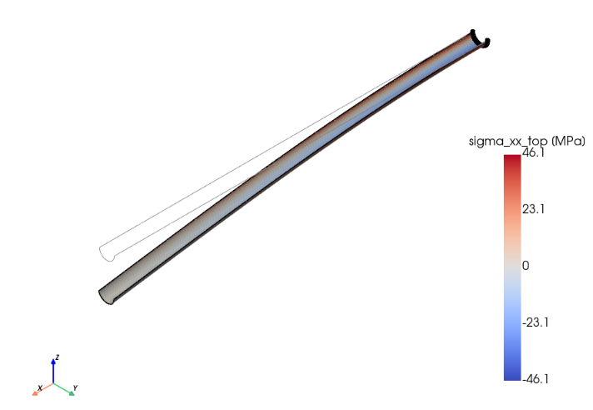
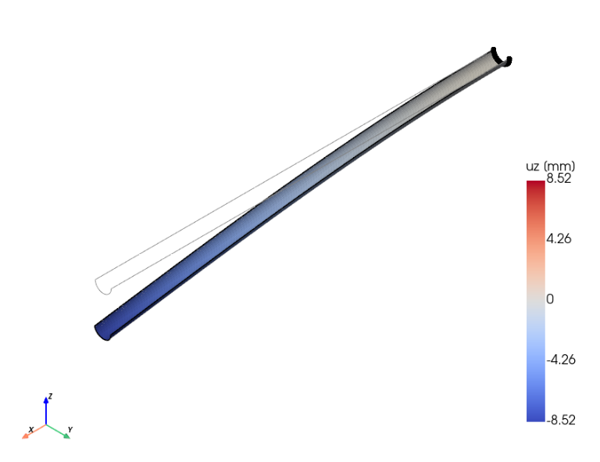
OpenSeesPy Pipeline: Plots, Objective, Constraints
7
Axial stress σ_{xx} on the top ply from bending
Transverse deflection u_{z} (drawing exaggerated 11.7×)
Output: objective/constraint check
✓ Working
10.42 g
Mass (objective); hand check agrees
4.2×10⁻⁴
Max Hashin index in bending, 1 N tip load (fiber tension)
0.136
Hashin index from flattening for coiling (governs; all F < 1)
Notes:
Suggested presenter: Tara.
Left: axial stress sigma_xx on the top ply from bending. Right: transverse deflection u_z; the drawing is exaggerated 11.7x but the numbers on the colorbar are the true values (max 8.52 mm, as in the table on the previous slide).
Objective/constraint check: mass 10.42 g with the catalog density 1580 kg/m^3 (hand check 1000 x 62.83 x 0.105 mm^3 x 1.58 g/cm^3 gives the same). Largest Hashin index under the 1 N load 4.2e-4: fiber tension in the bottom ply at the clamp, sigma1 ~ 50 MPa vs Xt = 2501 MPa. Flattening the R = 20 mm arc for coiling gives F = 0.136 (matrix tension), which governs; F < 1 so the design passes the no-failure check.

Slide 8
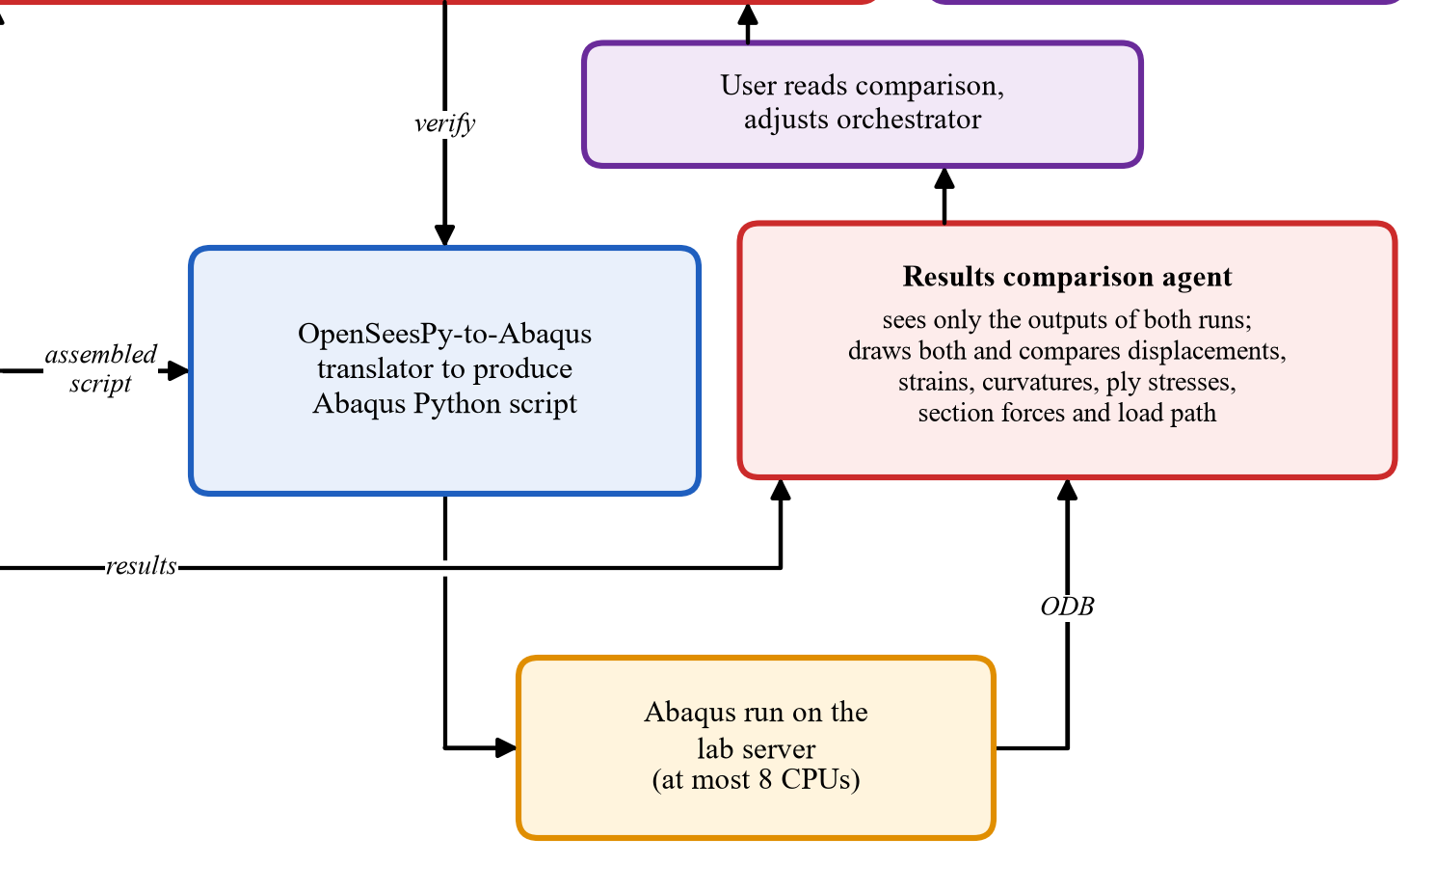
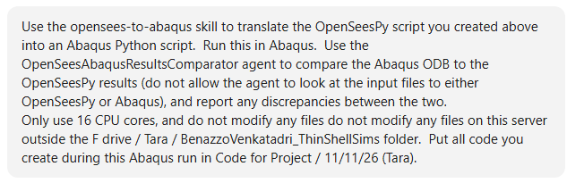
Abaqus Verification Loop
8
Input / Output Example
✓ Working
Input: prompt (same tape spring as the previous slides)
What this section does:
Careful on a shared lab server: at most 16 CPU cores in total (Abaqus at most 8, through a wrapper that enforces the limit), and nothing written outside the project repository folder
Translates the OpenSeesPy script to Abaqus, which Claude now runs on the lab server. An independent agent that sees only the two outputs checks that they agree and discusses any discrepancies.
Why a separate comparison agent? Information split: the orchestrator sees the OpenSeesPy and Abaqus input files; the comparison agent sees only the two outputs, to avoid confirmation bias
Output: OpenSeesPy and Abaqus agree within 0.7% (next slide)
Notes:
Suggested presenter: Tara.
Because the GitHub repository now lives on the lab server, Claude runs Abaqus itself: the human steps that moved files between machines and the ODB extraction step are gone from the diagram.
Care on the shared server: every Abaqus run goes through .claude/orchestrator/tools/run_abaqus.py, which caps the CPUs (default 1, at most 8; the prompt allowed 16 cores in total) and refuses to write outside the project repository folder (PROTOCOL.md section 6a).
Why the results comparison agent is separate: the information available to the agents is split. The orchestrator writes and sees the input files of both models (the OpenSeesPy script and, through the translator tool, the Abaqus script). The OpenSeesAbaqusResultsComparator agent was not allowed to read either input file; it only saw the two result files, so it cannot be biased toward confirming the models it is checking (an agent should not verify its own work).

Slide 9
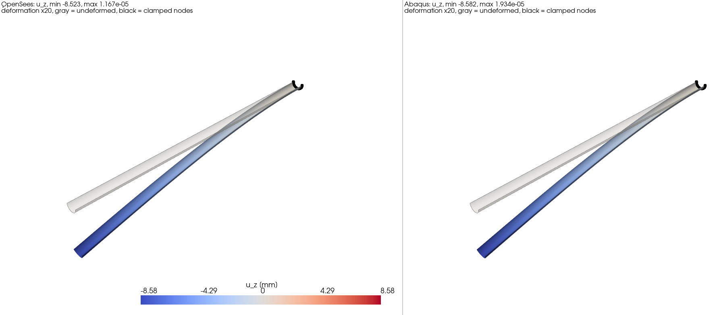
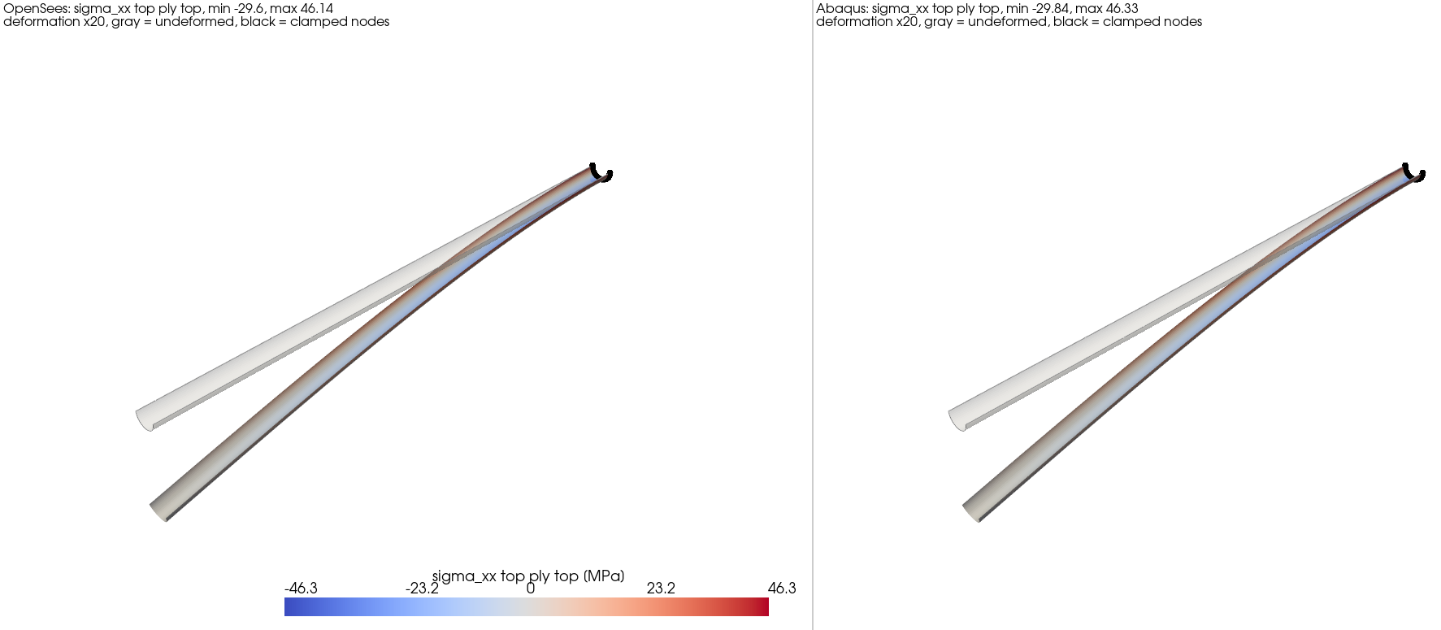
Abaqus Verification Loop: Results
9
Quantity | OpenSees | Abaqus | Diff.
Tip u_{z} (mm) | −8.523 | −8.583 | 0.70%
Tip rotation (rad) | 0.01266 | 0.01275 | 0.70%
σ₁, top ply (MPa) | 46.14 | 46.33 | 0.4%
τ₁₂, top ply (MPa) | 0.355 | 0.354 | 0.1%
σ_{xx} range, top ply (MPa) | −29.6 to 46.1 | −29.8 to 46.3 | < 1%
Agree within 0.7%
Acceptable: the two codes model shell elements, layered composites and loads/BCs differently
✓ Working
Comparator agent saw only the two result files
Notes:
Suggested presenter: Tara.
Comparison written by the OpenSeesAbaqusResultsComparator agent from the OpenSeesPy .npz and the Abaqus ODB extract only. Pictures: deformation x20, grey = undeformed, black = clamped nodes; top: u_z, bottom: sigma_xx on the top ply.
Differences under 1% are acceptable: OpenSeesPy (ASDShellQ4 with LayeredShell sections) and Abaqus (S4R with a composite layup) use different shell elements, integrate the layers differently and apply the loads/BCs differently (rigid links vs. coupling).

Slide 10
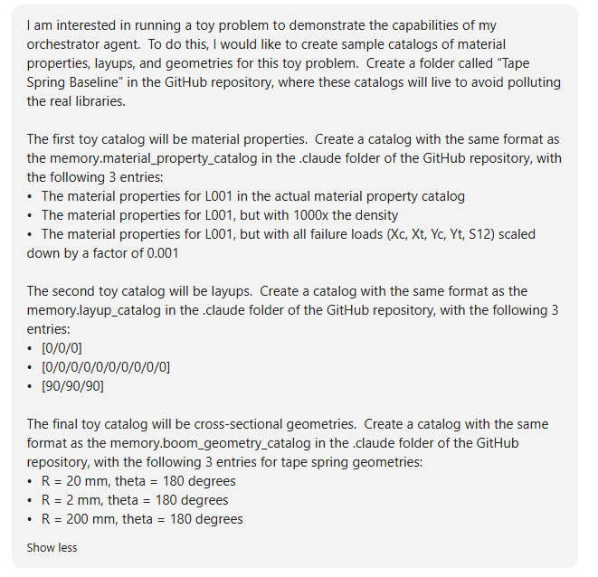
End-to-End Baseline: Sandboxed Catalogs
10
Goal: show that the full orchestrator finds the design a human knows to be optimal
Input: prompt to create the toy catalogs
Output: 3 × 3 × 3 = 27 possible designs
✓ Working
Role | Material | Layup | Geometry
Should be optimal | L001 (slide 3) | [0/0/0] | R = 20 mm, 180°
Heavier | L001, 1000× density | [0]₁₀, 3.3× thicker | R = 200 mm
Should fail | L001, strengths × 0.001 | [90/90/90] | R = 2 mm
L001: IM7/8552 row of the material catalog (slide 3)
Heavier: works against the objective of the lightest boom
Should fail: should trigger material failure ([90/90/90] should also miss the deflection limit)
Sandbox copy of the orchestrator; real catalogs untouched
Notes:
Suggested presenter: Tara.
Goal: demonstrate that the full orchestrator system works on a subset of materials, layups and geometries, and that it finds the solution a human knows to be optimal.
Sandbox: the orchestrator tools read the catalogs from fixed paths and the protocol forbids editing them, so the run used a copy of the orchestrator, skills and verifier in Code for Project/11-11-26 (Tara)/toy_orch/.claude/ with the three toy catalogs as its memory folders. The real .claude/ and catalogs were not touched.
Why each option: [0/0/0] should be optimal since only axial stresses are induced and off-axis plies are not needed; [0]10 is far too thick (mass, coiling stresses); [90/90/90] has too little stiffness and strength along the boom. R = 2 mm is so tightly curved that coiling should fail the material; R = 200 mm adds a lot of mass. L001 x1000 density cannot win on mass; L001 strengths x0.001 should fail.

Slide 11
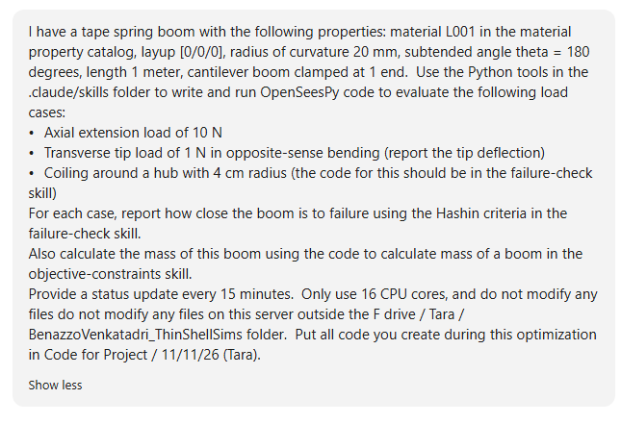
End-to-End Baseline: Tools Only, No Agents
11
Optimization setup
Objective: minimum mass
Constraints:
Tape spring, 1 m long
Cantilever: clamped root, free tip
10 N axial extension: no failure
1 N opposite-sense tip load: deflection ≤ 2 cm, no failure
Coils on a 4 cm radius hub: no failure
Baseline: tools only, on the known optimum (L001, [0/0/0], R = 20 mm)
Input: prompt to run the tools on the known optimum
10.42 g
Boom mass
✓ Working
Output: all three load cases pass
Load case | Result | Hashin F | Strength ratio
10 N axial | Extension 0.0096 mm | 4.0×10⁻⁷ | 1576
1 N tip load | Deflection 8.52 mm | 4.2×10⁻⁴ | 49
Coiling, 4 cm hub | — | 0.183 | 2.34
Strength ratio R = 1/√F: factor by which the load can grow before Hashin failure (F = 1)
Notes:
Suggested presenter: Tara.
First the deterministic OpenSeesPy tools were run, without the orchestrator agent, on the design a human expects to be optimal: this is the baseline the orchestrator should reproduce.
Axial: tip extension 0.00957 mm (PL/EA 0.00951). Tip load: 8.52 mm on the 2.5 mm mesh (8.50 mm on 1.25 mm; PL^3/3EI = 8.41 mm). Coiling on the 40 mm hub: flattening (1/R) plus hub curvature (1/40), worst of four signs, F = 0.183, matrix tension in the outer ply. Mass 10.42 g, same as the hand check rho b h L.

Slide 12
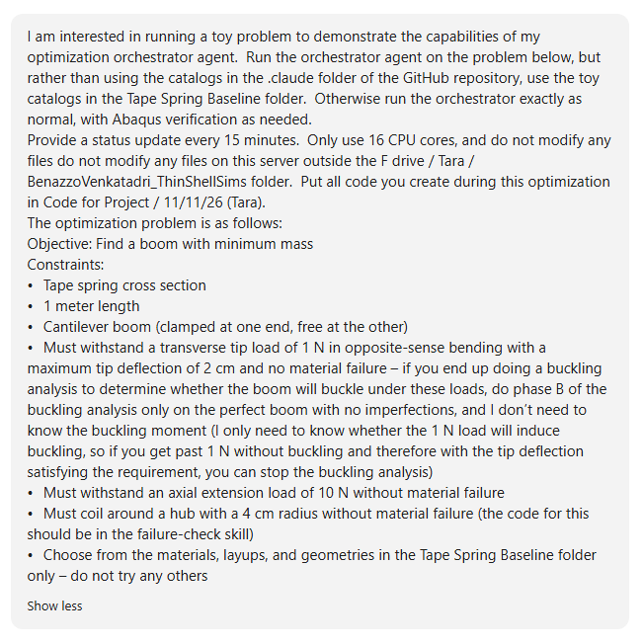
End-to-End Baseline: Orchestrator Run
12
Input: prompt to the orchestrator
Output: optimal design vs. baseline vs. Abaqus
✓ Working
Quantity | Baseline, 2.5 mm mesh | Orchestrator, 5 mm mesh | Abaqus, 5 mm mesh
Mass (g) | 10.42 | 10.40 | –
Tip deflection, 1 N (mm) | 8.52 | 8.60 | 8.82
Tip rotation (rad) | 0.0127 | 0.0128 | 0.0131
Peak σ₁ at root (MPa) | 50.0 | 47.7 | 42.6 (top ply)
Hashin F, 1 N tip load | 4.2×10⁻⁴ | 3.7×10⁻⁴ | –
Hashin F, 10 N axial | 4.0×10⁻⁷ | 3.9×10⁻⁷ | –
Hashin F, coiling on hub | 0.183 | 0.183 | –
Optimum = human-chosen baseline: L001, [0/0/0], R = 20 mm
Matches the baseline; differences come from the mesh size
Abaqus agrees within ~3%; no buckling under the 1 N load
Notes:
Suggested presenter: Tara.
The orchestrator ran exactly as normal (study.py state machine, the same skills and checks) on the toy catalogs, with Abaqus verification. Its optimum is the human-chosen baseline. All major quantities agree with the tools-only baseline within slight differences from the mesh size (baseline 2.5 mm, orchestrator 5 mm). Abaqus (5 mm mesh): tip deflection +2.6%, peak ply stress +2.1% (study report); the 42.6 MPa is the top ply, the 47.7 / 50.0 MPa are the peak over all plies.
Buckling (asked to stop once past 1 N): perfect-boom phase-B path reached 1037 N mm > 1000 N mm root moment with no limit point; Abaqus buckling on the perfect geometry: linear eigenvalue 4336 N mm, Riks limit point 1395 N mm, both above 1000 N mm. Mesh convergence 5 -> 3 mm: tip stiffness 0.72%.

Slide 13
Orchestrator Ruled Out 19 of 27 Designs Before FE
13
[0/0/0]
[0]₁₀
[90/90/90]
Pre-checks without FE: exact CLT coiling index and beam-theory stiffness
19 of 27 rejected, so only 8 FE iterations were needed
Optimum found first; the other 7 feasible designs were heavier
R (mm)
20
2
200
20
2
200
20
2
200
L001
Real
it1
C,S
it2
C
C,S
it5
S
C,S
it4
L002
×1000 ρ
it3
C,S
it6
C
C,S
it8
S
C,S
it7
L003
Weak
C
C,S
C
C
C,S
C
C,S
C,S
C
The full orchestrator architecture works as intended
it1
Optimum, found at iteration 1
it#
Feasible but heavier (FE iteration #)
Next step: many realistic materials, layups and geometries; the orchestrator pre-screens for viable designs and runs the needed grid search much faster than a human
C
Fails coiling: flattening + 4 cm hub gives Hashin F ≥ 1 (too thick, R too tight, or weak material)
S
Fails stiffness: beam theory gives > 2 cm deflection ([90/90/90]; R = 2 mm since I scales as R³)
Notes:
Suggested presenter: Tara.
Before the first iteration, the orchestrator's design screen checked all 27 combinations with exact or near-exact formulas: coiling with exact CLT + Hashin 2D (the flattened, hub-bent flange has a known uniform curvature state, so no FE is needed) and stiffness with thin-walled beam theory (k = 3 E_x I / L^3, rejected below 0.85 x 0.05 N/mm). 17 fail coiling, 12 fail stiffness (some both): every L003 row (strengths x0.001), every T002 row (R = 2 mm) and [0]10 on R = 20 mm fail coiling; [90/90/90] on R = 20 mm and every R = 2 mm row fail stiffness. Mass was not used to reject anything.
Only the 8 survivors were run through the FE loop (8 iterations instead of 27). Iteration 1 was already the optimum; the other 7 feasible designs are all heavier (R = 200 mm or 1000x density).
Next step: go beyond the baseline to problems a human could not solve by hand: far more materials, layups and geometries, all of them realistic (unlike the altered ones here).

Slide 14
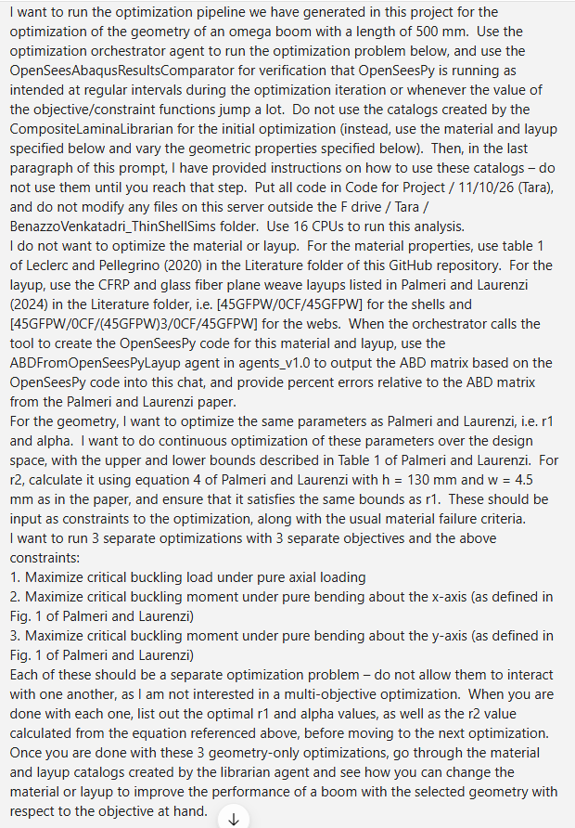
Failure Case: Omega Boom of Palmeri and Laurenzi [1]
14
Input: prompt
Output
✗ Failing
Expected | Reproduce the published optimal omega-boom geometry for maximum buckling load and moments
Returned | After hours, no working mesh convergence study even on the paper's optimal design
Likely cause | Outside the orchestrator's scope: user-given material and layup instead of catalogs, continuous variation of the geometry instead of discrete catalog rows, and buckling analyses that OpenSeesPy and the existing skills do not support for this closed section
Outcome | Abandoned for the simpler tape-spring baseline (slides 10-13)
[1] Palmeri, F., & Laurenzi, S. (2024). Neural network-based surrogate modeling for buckling performance optimization of lightweight-composite collapsible tubular masts. Biomimetics, 9(8), 494.
Notes:
Suggested presenter: Tara (11/10 attempt; conversation in Claude Conversations/Tara 11-10-26 Conversation 1).
This was first considered as the baseline: reproduce the omega (collapsible tubular mast) geometry optimization of Palmeri and Laurenzi (2024) for maximum buckling load / moments. It turned out to be outside the scope of the optimization orchestrator: the material and layup were given by the user instead of taken from the catalogs, the geometry (r1, alpha) was optimized continuously instead of picked from discrete catalog rows, and the buckling simulations differed from the ones the existing skills set up. Claude worked for hours but could not even get a mesh convergence study to work on the paper's optimal design, because of OpenSeesPy's limited buckling capabilities for this closed section. It was abandoned in favor of the simpler tape-spring baseline of the previous slides.

